Slide 1


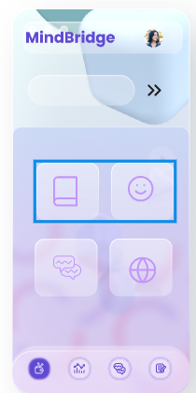

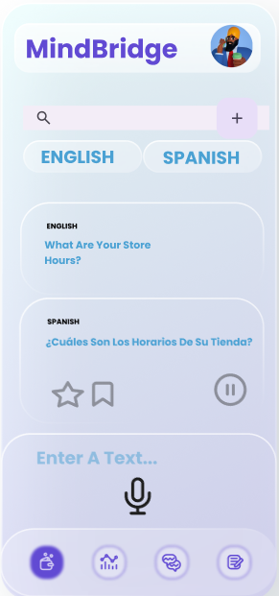

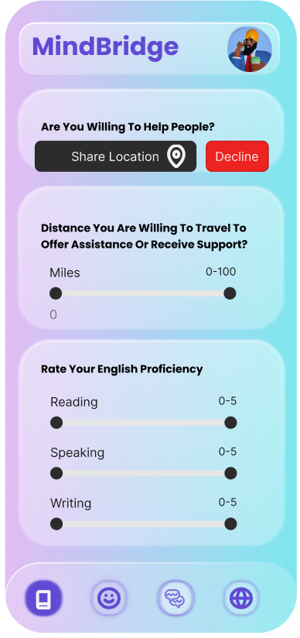
MindBridge
CodeAI

Slide 2
App designed to help immigrants and refugees integrate into American society by offering translation services, cultural food recommendations, mental health support, and language learning tools
Hi Lee!

Slide 3
Unlike standard translation tools, Users can select specific dialects and regional variations for more accurate, culturally resonant translations.
Translator with Dialect Preferences
Incorporates local expressions and cultural nuances, ensuring translations are both linguistically accurate and culturally appropriate.

Slide 4
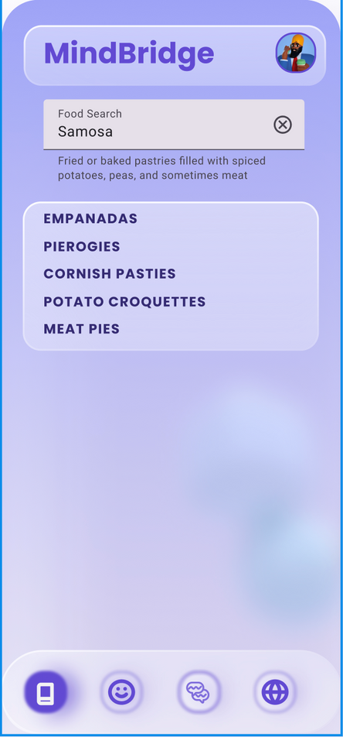
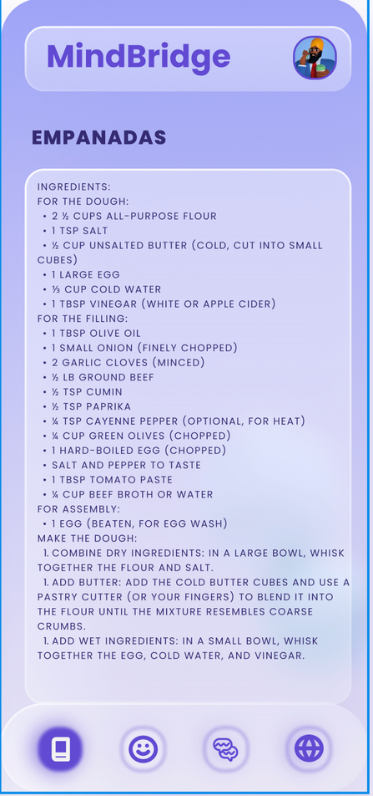
Taste Match
Users can input a food item from their own culture or region, and the feature will provide results of similar-tasting dishes available in the USA
Along with the matched dishes, users will also receive recipes, allowing them to recreate the taste of home with locally available ingredients

Slide 5
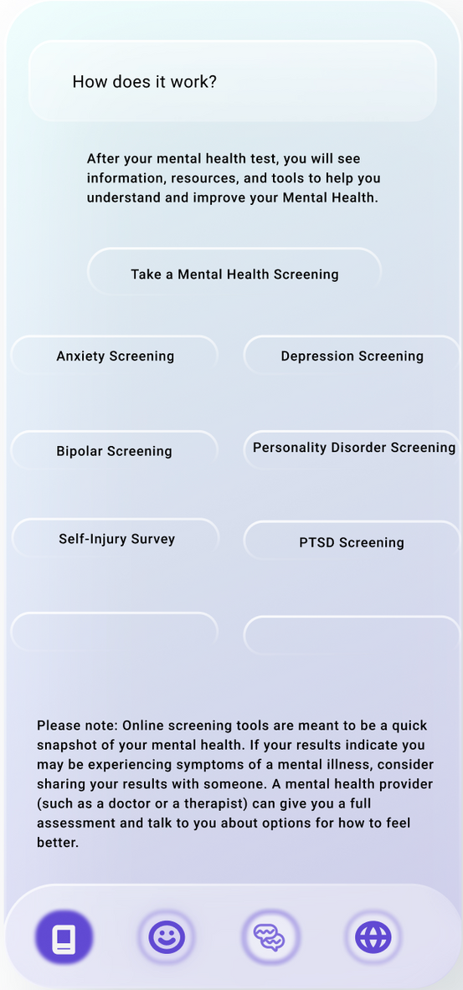
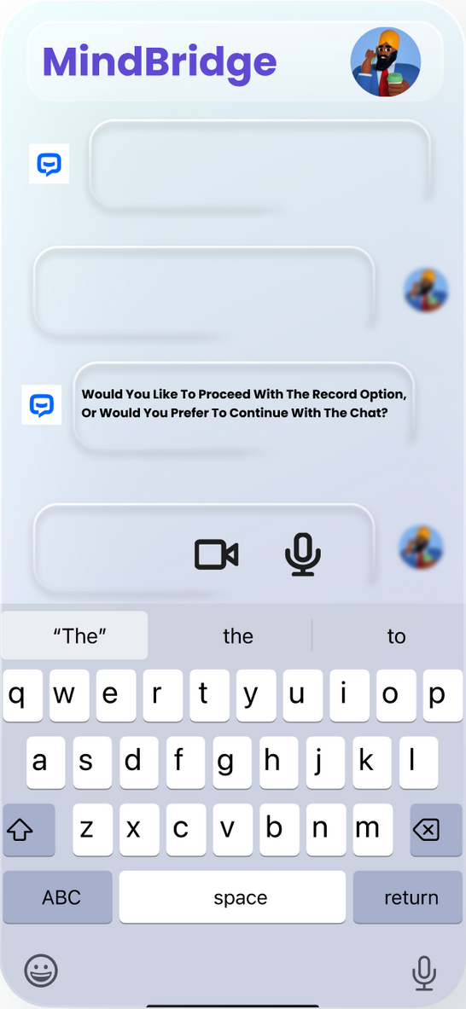
Chatbot
You can start a conversation or record your thoughts to begin the mental health assessment process in a comfortable and non-intrusive way.
Receive personalized mental health screenings, track your mood over time through a dashboard, and access resources like articles, videos, or connect with nearby users.
If necessary, get routed to a mental health professional for further support and guidance.

Slide 6
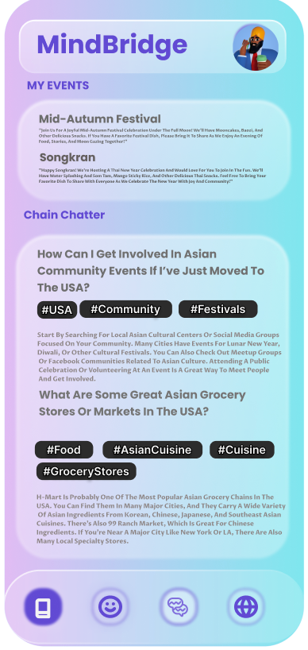
Connect U
Connect U is an app that helps culturally diverse groups connect and help each other.
It includes a community-driven Q&A feature where users can ask questions and receive answers from others within their cultural groups, fostering better adaptation

Slide 7
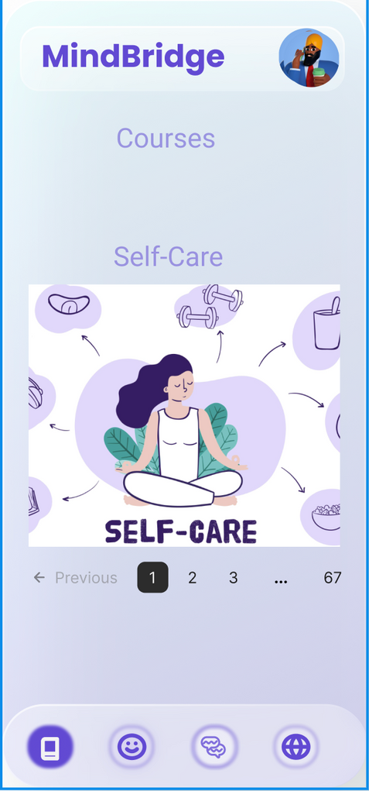
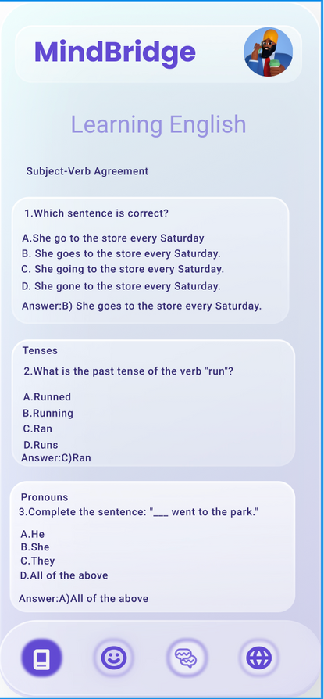
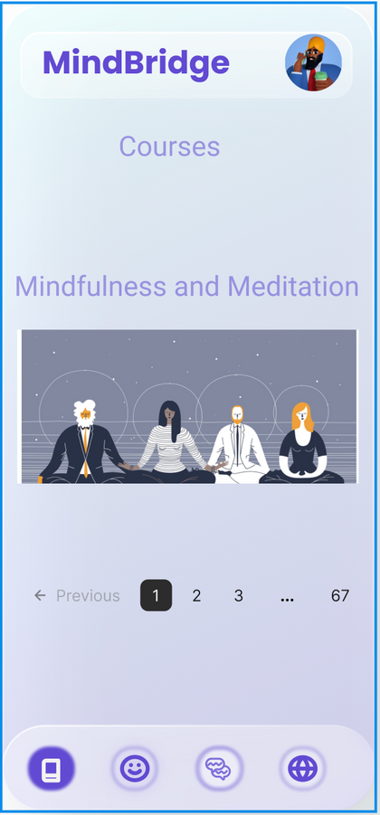
LearnNest
An app for refugees and immigrants to learn English,
and mini-courses on self-care, mental health, and meditation to support overall well-being.

Slide 8
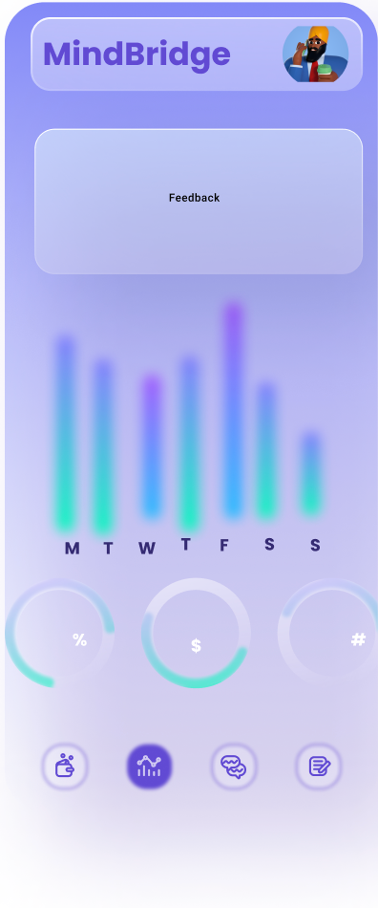
Tools & Technologies
Our model employs a sequence-to-sequence architecture with a bidirectional LSTM encoder and an LSTM decoder, enhanced by an attention mechanism to focus on relevant parts of the input during decoding.
We utilize a custom AccumulatedModel class for gradient accumulation, enabling efficient training by updating the model's weights after processing multiple mini-batches.
We have carefully selected datasets to mirror real-world scenarios and requested access to documented therapist conversation datasets from a 2019 research study.

Slide 9
Implementation
Mobile Framework: Flutter
Backend Technology: Go
Taste Match:
Tools & Technologies: Bert, Spoonacular API, Tensorflow
Datasets: Food-101, Recipe1M.
Connect U:
Tools & Technologies: Bert, SpaCy, NLTK, Tensorflow, Elasticsearch
Translator with Dialect Preferences:
Tools & Technologies: TensorFlow,Google Translate API,Hugging Face Transformers,OpenNMT

Slide 10
Implementation
LearnNest
Tools & Technologies : Flutter for cross-platform mobile development and Node.js with a MongoDB
APIs: Language learning APIs, Mental health APIs
Chatbot
Technologies : Dialogflow, Node.js and Flutter
Dataset: Mental Health in Tech Survey

Slide 11
Our Team
Prajakta
Aishwarya
Priyadarshni
Shraddha
Nishanth

